Slide 1
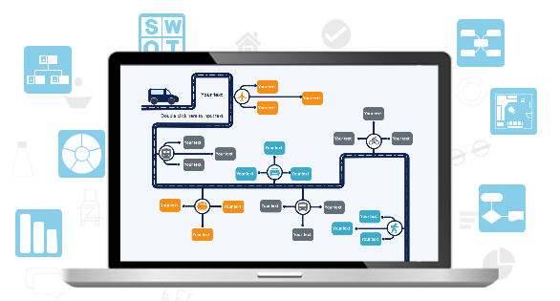
Edraw Max All-in-One Diagramm Software
Professional diagram software for Windows, Mac and Linux.
Provides all visualization solutions from diagram drawing, graphic design to data visualization.
Official Webseite：https://www.edrawsoft.com/edraw-max.php

Slide 2
Edraw Max Stimulate your creativity. Create perfect diagrams.
01
All-in-One Diagramm Software
02
Abundant Templates & Examples
03
Extensive Vector Symbols
04
Smart & Intuitive Drawing
05
Used as a Visio Alternative

Slide 3
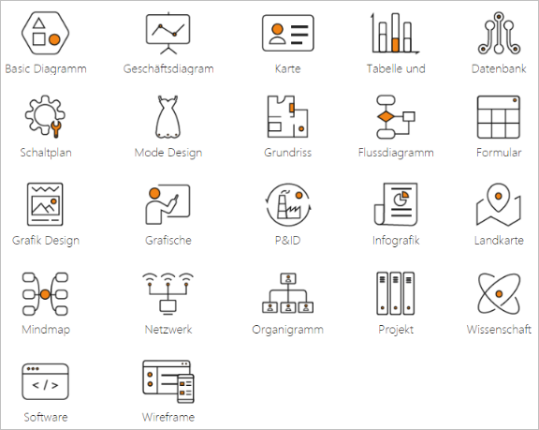
Edraw Max - All in One Diagramm Software
Edraw max is an all-in-one diagramming tool which can handle more than 260 types of diagrams, including flowcharts, org charts, electrical diagrams, infographics, etc.
Flowchart
Network Diagram
Organizational Chart
Business Diagram
Science and Education
Mind Map
Fashion Design
UML Diagram
Workflow Diagram
Software Development
Infographics
Electrical Diagram
P&ID
Clipart
Floor Plan
Charts and Graphs
Gantt Chart
Map
Web Diagram
Graphic Organizers
Card
And more…

Slide 4
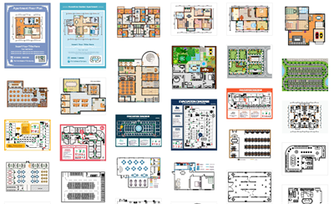
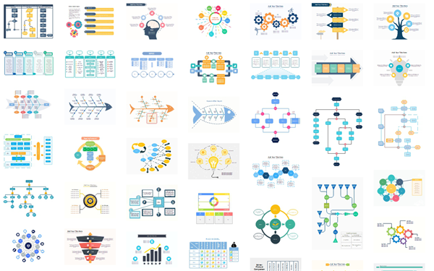
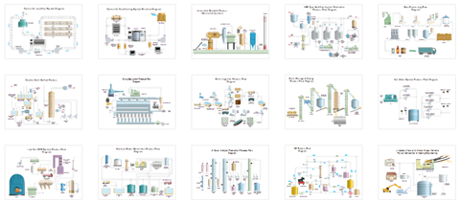
Thousands of Templates Free to Use
There are templates for each drawing type that help users start quickly and save time. You can find 3000+ templates in total in Edraw Max.

Slide 5
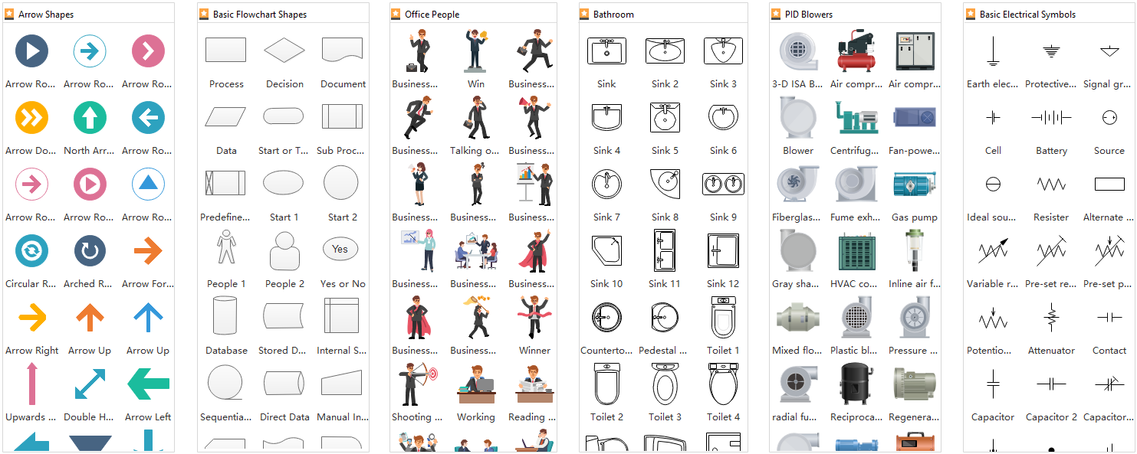
Rich Symbols and Elements
The software offers more than 12000 vector symbols. Simply drag and drop the symbols to create your designs.

Slide 6
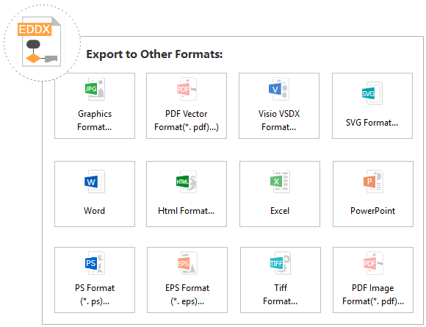
Export to Other File Formats with 1 Click
Through one click you can turn your drawing to other file formats such as PDF, JPG, Word, Excel, PPT, Html, Visio, etc.
JPG, PNG
PDF
VSDX
DOCX (Word)
PPTX (PowerPoint)
XLSX (Excel)
SVG
HTML
SVG
PS, EPS
TIFF

Slide 7
Present Data Attractively in Diagrams and Charts
Make data clear at a glance.
Combine data with diagrams.
Make your diagrams and charts more dynamic by inserting hyperlinks, notes and attachments.

Slide 8
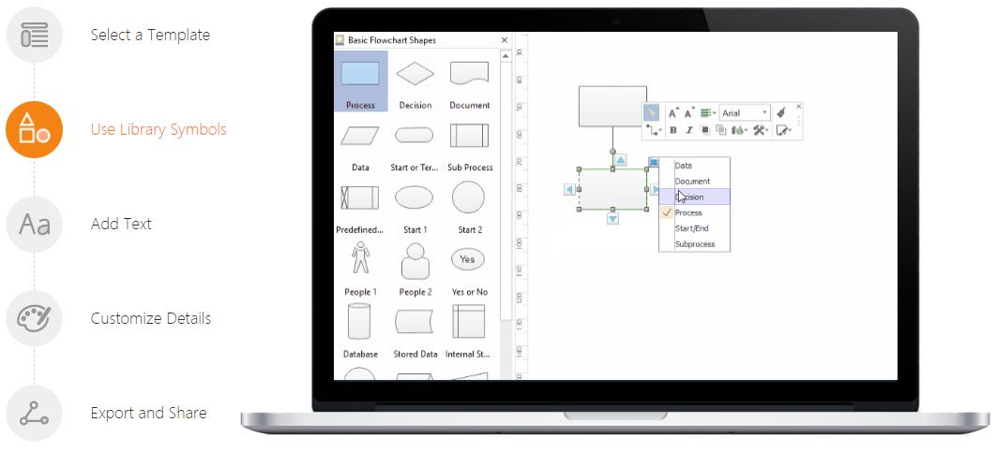
No Drawing Skill is Required
You can create a diagram in only 5 steps, no drawing skill is needed.
1.
2.
3.
4.
5.
Tutorials: https://www.edrawsoft.com/howitworks.php

Slide 9
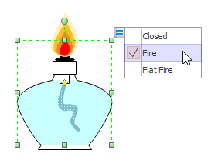
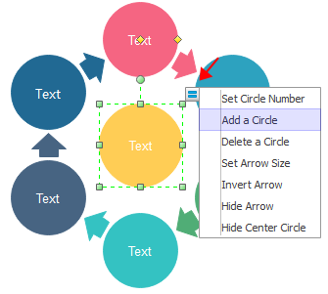
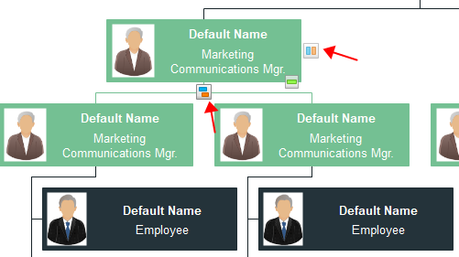
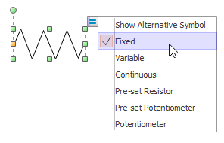
Use Quick Floating Buttons
The quick floating buttons allow you to reach the result your want in a smarter way.
For example: By clicking the floating button, you can quickly change another symbol style.

Slide 10
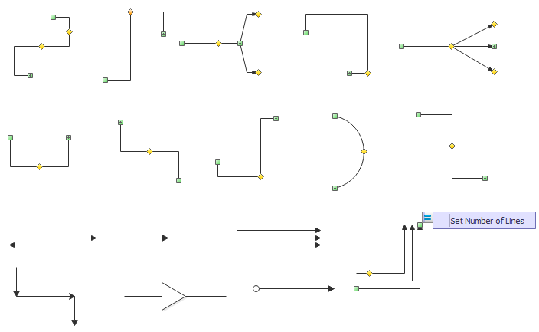
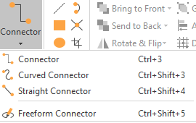
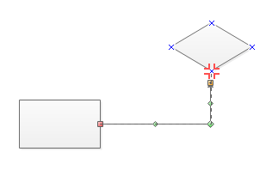
Use Smart Connector to Connect Shapes
The connectors can be glued to shapes so that when you move the shapes it will remain connected.

Slide 11
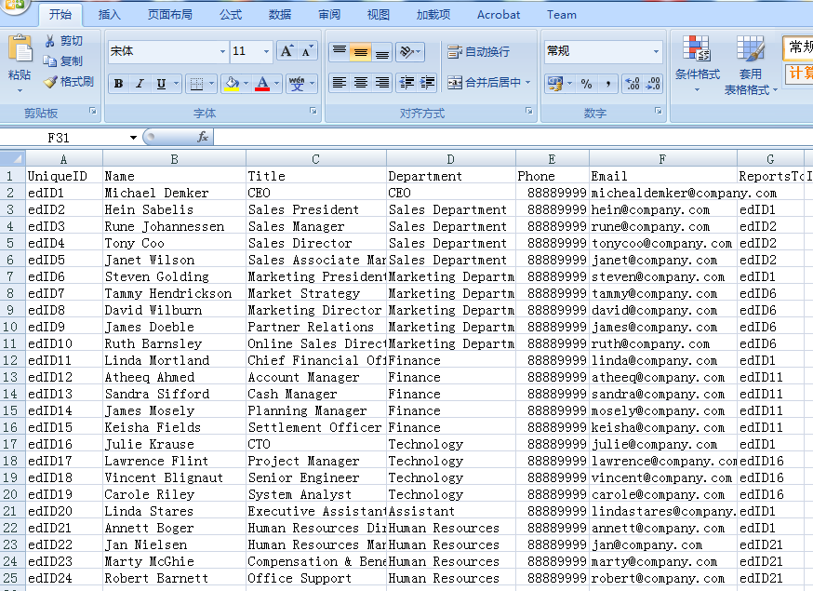
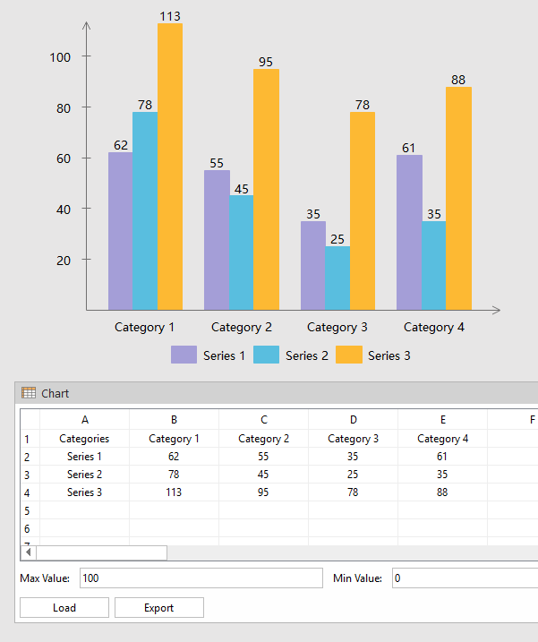
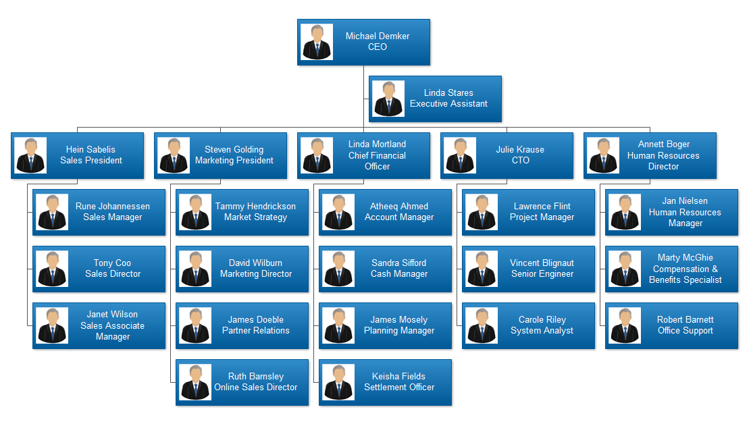
Data-interactive Charts
Smart Wizard enables users to easily convert data into diagrams and vice versa.

Slide 12
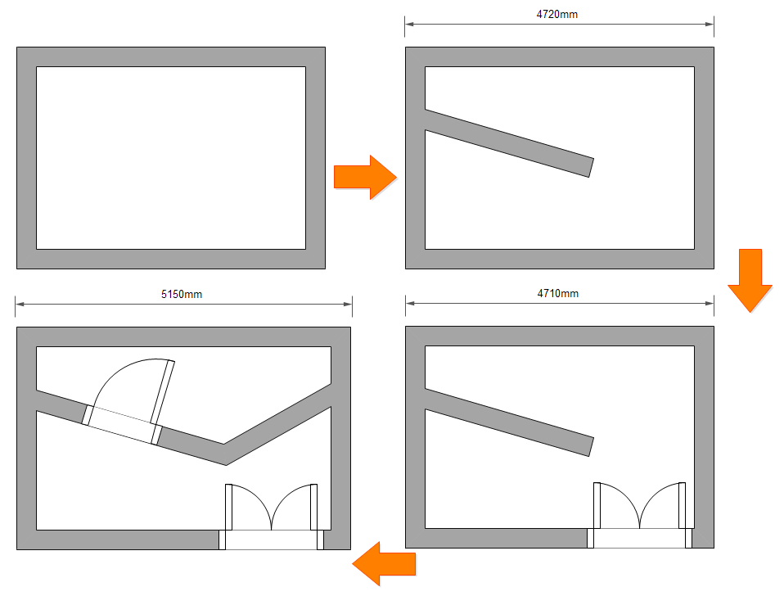
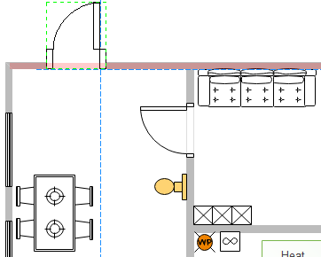
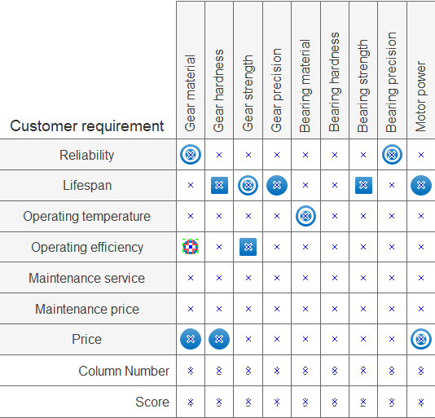
Automatically Snap and Glue
The snap and glue function makes it easy to connect shapes and combine shapes together.

Slide 13
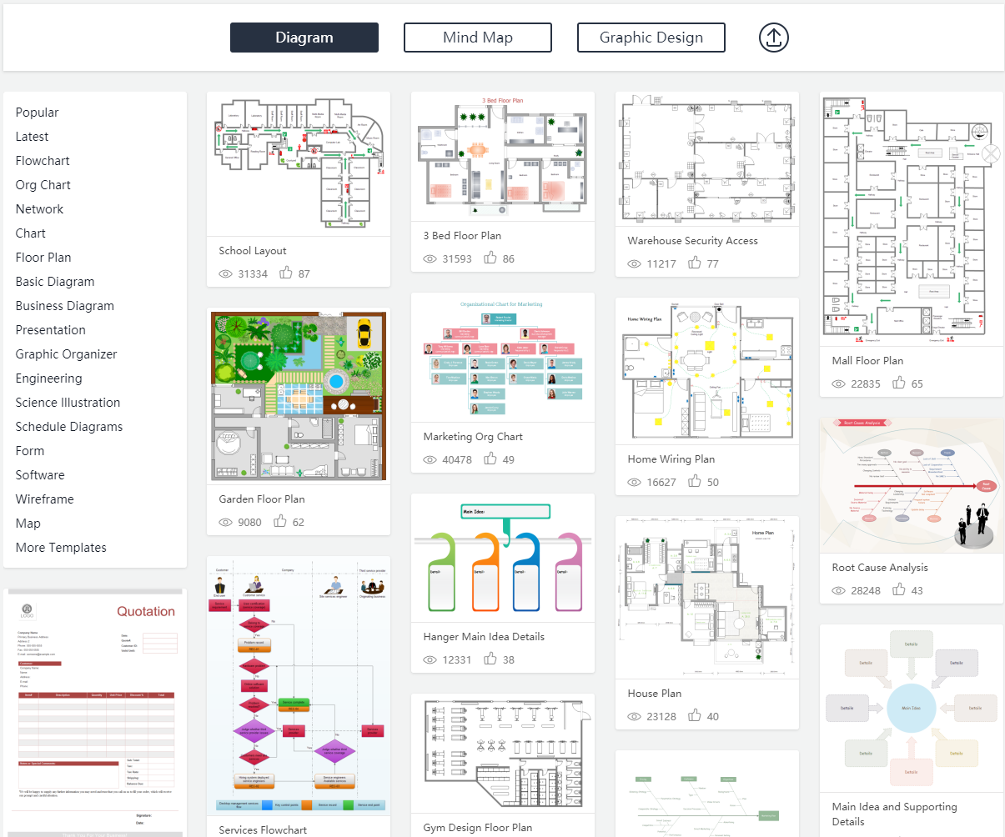
Free Online Templates Center
You can search more templates from our Online Templates Center. You can also contribute templates so that other people could benefits from your contribution.

Slide 14
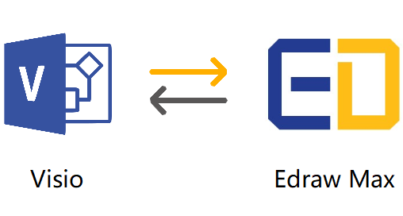
Edraw Max - A Solid Alternative to Microsoft Visio
Compatible with Visio .vsdx Files
Edraw Max has a pretty fine compatibility with Visio .vsdx files. Supports both import and export of Visio files.
Works on Windows, Mac and Linux
It's cross-platform based, and used as the best alternative for Visio users with Mac and Linux OS.
More Templates and Symbols than Visio
It has 12000+ symbols and 3000+ templates, and offers more drawing types including even infographics, charts, and graphic organizers.
Less Expensive and Better Service than Visio
It's much more affordable, and you can get a 24-hour email service.

Slide 15
Competitive Advantage of Edraw Max – Low Cost
Edraw Max is also quite advantageous in terms of license fee. You can spend a small amount of money yet receive more value.
With Edraw Max, you can choose an one-time fee instead of paying it for every year.

Slide 16
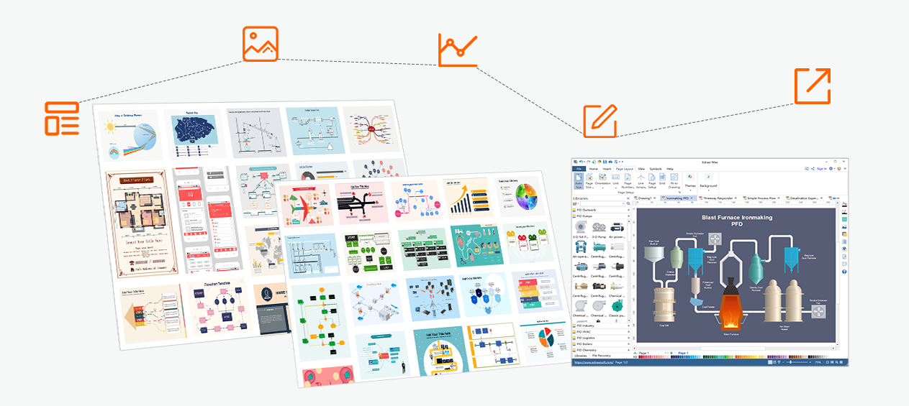
Thank You!
Edraw Max
All-in-one Diagram Design Software
http://www.edrawsoft.com
support@edrawsoft.com

